Slide 1
Tentative schedule
Today (July 23)
Introduction and
Sediment characterization
Tomorrow (July 24)
Brief review of open channel flow
Exner equation
July 27 (Monday)
Initiation of motion
July 28 (Tuesday)
Fluvial bedforms (intro)
July 29 (Wednesday)
Flow resistance
Foundations of stability analysis
July 30 (Thursday)
Bedload transport
July 31 (Friday)
Bedload transport
Stability analysis of fluvial bars
August 3 (Monday)
Seminar
Stability analysis of dunes
August 4 (Tuesday)
Total load calculations
August 5 (Wednesday)
Suspended load calculations
Weakly nonlinear stability analysis
If you have questions, I am in room 1A-69

Slide 2
Various
Main reference
Gary Parker’s e-book 1D Sediment Transport Morphodynamics with applications to rivers and turbidity currents. Freely downloadable at http://hydrolab.illinois.edu/people/parkerg/morphodynamics_e-book.htm
Voluntary group work
viparell@cec.sc.edu or eviparelli@gmail.com or eviparelli@unina.it

Slide 3
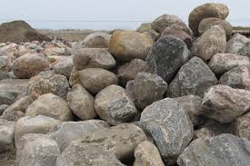
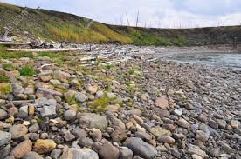
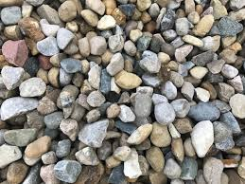
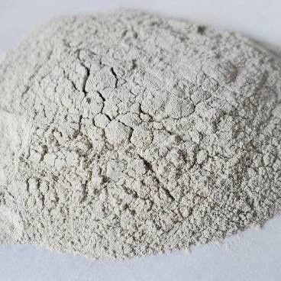
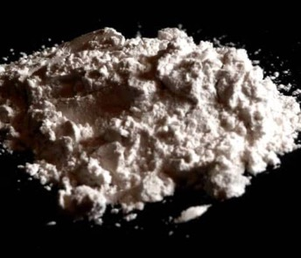
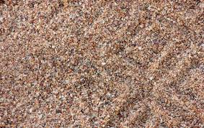
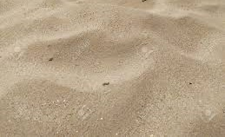
Sediment
Boulders
Pebbles / cobbles
Gravel
Coarse sand
Fine sand
Silt
Clay

Slide 4
Sediment size (diameter D)
Boulders
(D > 256 mm)
Pebbles / cobbles
(D = 64 mm – 256 mm)
Gravel
(D = 2 mm – 64 mm)
Coarse sand
Fine sand
Silt
(D = 0.002 mm – 0.0625 mm)
Clay
(D < 0.002 mm)
Sand (D = 0.0625 mm - 2 mm)

Slide 5
Sediment size (diameter D)
6 orders of magnitude
properties and transport
way to compare sediment sizes
Boulders
(D > 256 mm)
Pebbles / cobbles
(D = 64 mm – 256 mm)
Gravel
(D = 2 mm – 64 mm)
Coarse sand
Fine sand
Silt
(D = 0.002 mm – 0.0625 mm)
Clay
(D < 0.002 mm)
Sand (D = 0.0625 mm - 2 mm)

Slide 6
Sediment size (diameter D)
6 orders of magnitude
properties and transport
way to compare sediment sizes
Boulders
(D > 256 mm)
Pebbles / cobbles
(D = 64 mm – 256 mm)
Gravel
(D = 2 mm – 64 mm)
COHESIVE
Coarse sand
Fine sand
Silt
(D = 0.002 mm – 0.0625 mm)
Clay
(D < 0.002 mm)
Sand (D = 0.0625 mm - 2 mm)
electrochemical forces between particles

Slide 7
Bed material and wash material
Bed material forms the bed and lower banks of the river. It chiefly determines channel morphology. In alluvial channels, it corresponds with the coarser part of the sediment load (Church, 2006).
Wash material once entrained is transported for a long distance in suspension. This material is found only in minor quantities in the riverbed but may form a significant fraction of upper bank and floodplain deposits as the result of overbank deposition during floods (Church, 2006).

Slide 8
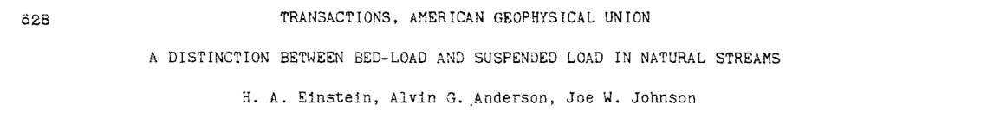
Grain sizes of bed and wash material
1940
How is sediment transported?

Slide 9
Bedload vs suspended load
Video 1
Video 2
From Gary Parker’s e-book

Slide 10
Grain sizes of bed and wash material
1940
How is sediment transported? does it matter?
NOTE: I do not consider organic matter and substances that are not sediment but are part of the mud.

Slide 11
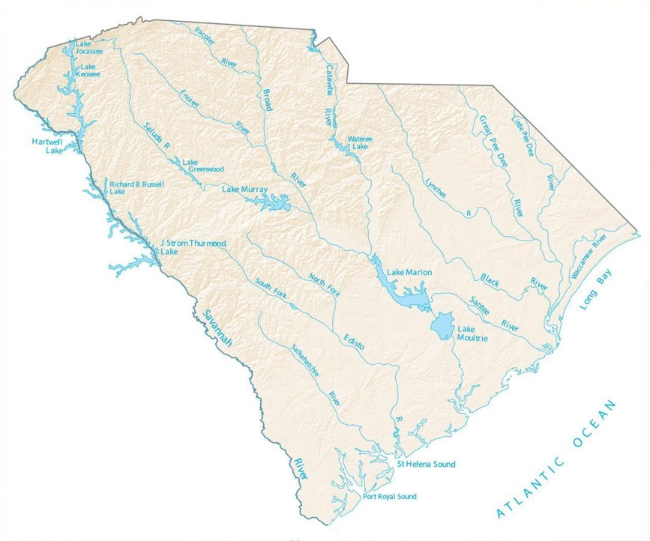
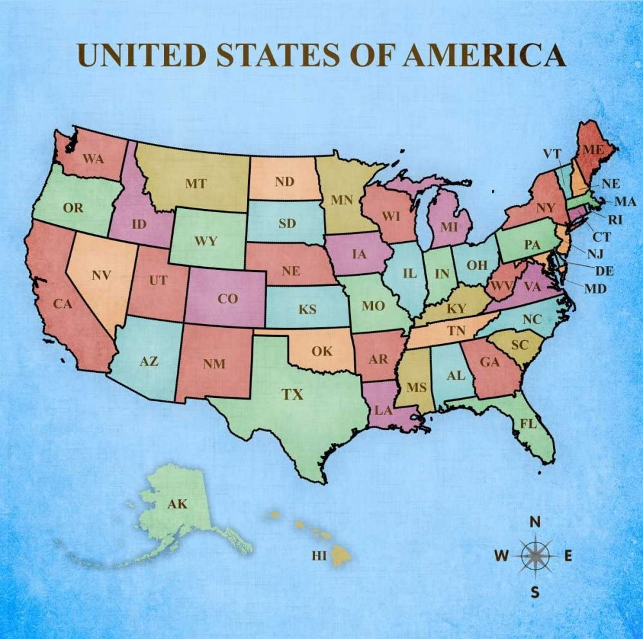
The Enoree River, SC

Slide 12
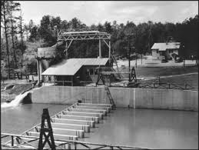
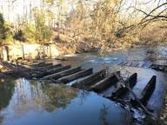
The Enoree River, SC
Soil Conservation Service field laboratory
12

Slide 13
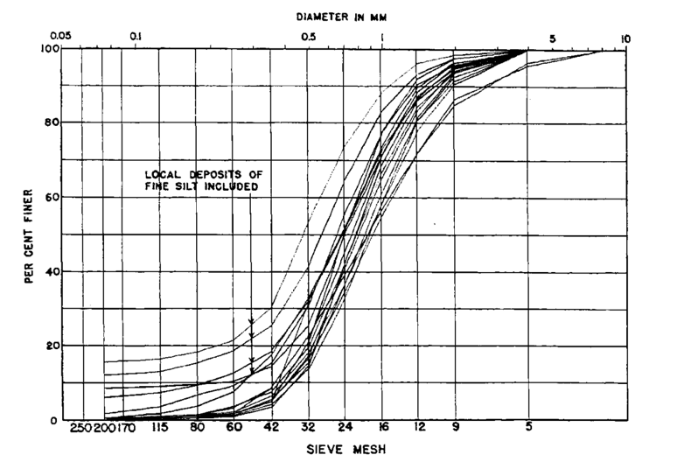
The Enoree River study
(Einstein et al., 1940)
Very little sediment finer than 0.315 mm (42 sieve mesh) and practically no sediment finer than 0.25 mm (60 sieve mesh) was found on the channel bed. Sediment collected in traps during a storm and sediment found on the bed had similar grain size distributions
Samples containing fine bank material

Slide 14
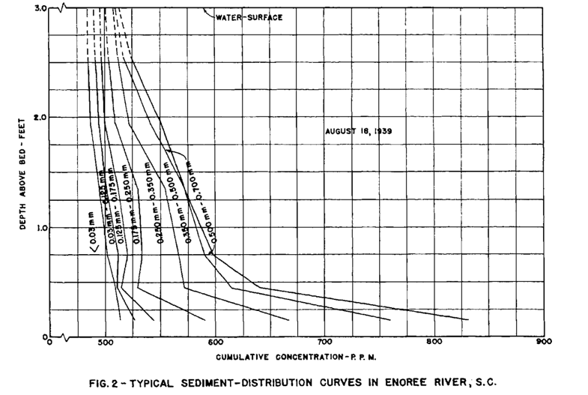
The Enoree River study
(Einstein et al., 1940)
Very little sediment finer than 0.315 mm (42 sieve mesh) and practically no sediment finer than 0.25 mm (60 sieve mesh) was found on the channel bed. Sediment collected in traps during a storm and sediment found on the bed had similar grain size distributions
Suspended load samples indicate nearly uniform distribution in the vertical for the finer sizes.
Particles coarser than 0.315 mm are found in suspension with higher concentrations near the bed
Grain size

Slide 15
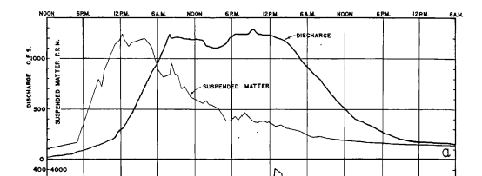
The Enoree River study
(Einstein et al., 1940)
Very little sediment finer than 0.315 mm (42 sieve mesh) and practically no sediment finer than 0.25 mim (60 sieve mesh) was found on the channel bed. Sediment collected in traps during a storm and sediment found on the bed had similar grain size distributions
Suspended load samples indicate nearly uniform distribution in the vertical for the finer sizes.
Particles coarser than 0.315 mm are found in suspension with higher concentrations near the bed
The peak of suspended load precedes that of water discharge

Slide 16
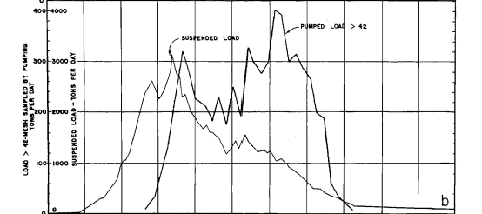
The Enoree River study
(Einstein et al., 1940)
Very little sediment finer than 0.315 mm (42 sieve mesh) and practically no sediment finer than 0.25 mm (60 sieve mesh) was found on the channel bed. Sediment collected in traps during a storm and sediment found on the bed had similar grain size distributions
Suspended load samples indicate nearly uniform distribution in the vertical for the finer sizes.
Particles coarser than 0.315 mm are found in suspension with higher concentrations near the bed
The peak of suspended load precedes that of water discharge
The suspended load consists for the 96% of sediment finer than 0.315 mm and follows a different curve than the material collected in the traps.
Suspended sediment
Trap sediment

Slide 17
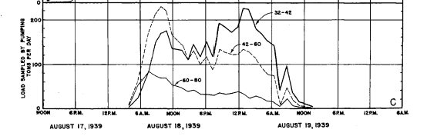
The Enoree River study
(Einstein et al., 1940)
Very little sediment finer than 0.315 mm (42 sieve mesh) and practically no sediment finer than 0.25 mm (60 sieve mesh) was found on the channel bed. Sediment collected in traps during a storm and sediment found on the bed had similar grain size distributions
Suspended load samples indicate nearly uniform distribution in the vertical for the finer sizes.
Particles coarser than 0.315 mm are found in suspension with higher concentrations near the bed
The peak of suspended load precedes that of water discharge
The suspended load consists for the 96% of sediment finer than 0.315 mm and follows a different curve than the material collected in the traps.
0.25 mm < d < 0.315 mm
d > 0.315 mm
d < 0.25 mm
The transport rate of particles coarser than 0.5 mm and with grain size between 0.315 mm and 0.5 mm varies in a similar way.
The transport rate of sediment with size between 0.18 mm and 0.25 mm resembles that of the silt
Sediment with grain size between 0.25 mm and 0.315 mm is a transition between the two but closer to the finest material

Slide 18
Summarizing, for the Enoree River
(Einstein et al., 1940)
Sediment coarser and finer than 0.315 mm are transported with different laws;
Sediment coarser than 0.315 mm is found in abundant quantities on the bed and its transport rate seems to vary with the flow discharge

Slide 19
Summarizing, for the Enoree River
(Einstein et al., 1940)
Sediment coarser and finer than 0.315 mm are transported with different laws;
Sediment coarser than 0.315 mm is found in abundant quantities on the bed and its transport rate seems to vary with the flow discharge
Sediment finer than 0.315 mm is contributed from the basin upstream and is transported downstream with minimum interaction with the bed, i.e. it is washed through. No relation exists between the load and the bed stress or the discharge

Slide 20
Site-specific distinction between bed and wash material
(Einstein et al., 1940)
“Bed material composition is determined from samples taken in the bottom of the channel in the reach under consideration immediately after a flood has receded to the normal low-water stage”

Slide 21
Site-specific distinction between bed and wash material
(Einstein et al., 1940)
“Bed material composition is determined from samples taken in the bottom of the channel in the reach under consideration immediately after a flood has receded to the normal low-water stage”
Bed material is composed of all particles that are greater than a limiting size whether moving as bedload or in suspension
Wash material composed of all particles finer than the limiting size which usually is washed into and through the reach under consideration

Slide 22
How is bed material transported? does it matter?
Bulk relations estimate Einstein’s bed load, sum of the bed material transported in suspension and as bedload (it may not matter)
Calculation of bed material load
Different models are used to compute bedload and suspended bed material load (it matters)

Slide 23
How is bed material transported? does it matter?
Bulk relations estimate Einstein’s bed load, sum of the bed material transported in suspension and as bedload (It may not matter)
Calculation of bed material load
Different models are used to compute bedload and suspended bed material load (it matters)
Calculation of wash load
Largely unresolved problem

Slide 24
It is common practice to set the grain size separating bed material from wash material equal to 62.5 microns. Is it always true?
No, it is not
The limiting grain size between bed material and wash material is not necessarily equal to 62.5 microns, grain size separating sand from silt.
This limiting grain size is probably site-dependent and can be determined with field measurements.

Slide 25

Sedimentological φ scale and the ψ scale
Sediment sizes vary over many order of magnitudes. It is thus convenient to use a logarithmic scale to express the variability in sediment size.
The sedimentological phi (φ) scale is a base-2 logarithmic scale defined as
$$φ=−\log_{2}D$$
where D is the sediment size in millimeters.

Slide 26
Sedimentological φ scale and the ψ scale
Sediment sizes vary over many order of magnitudes. It is thus convenient to use a logarithmic scale to express the variability in sediment size.
The sedimentological phi (φ) scale is a base-2 logarithmic scale defined as
$$φ=−\log_{2}D$$
where D is the sediment size in millimeters.

Slide 27
Sedimentological φ scale and the ψ scale
Sediment sizes vary over many order of magnitudes. It is thus convenient to use a logarithmic scale to express the variability in sediment size.
The sedimentological phi (φ) scale is a base-2 logarithmic scale defined as
$$φ=−\log_{2}D$$
we have numbers that do not vary too much;
coarse sediment is associated with small numbers
This is used by people working with fine material
where D is the sediment size in millimeters.
Sediment type | D (mm) | D (φ)
Boulders | > 256 | < -8
Cobbles and pebbles | 64 ~ 256 | -8 ~ -6
Gravel | 2 ~ 64 | -6~ -1
Sand | 0.0625 ~ 2 | -1 ~ 4
Silt | 0.002 ~ 0.0625 | 4 ~ 8.9
Clay | < 0.002 | > 8.9

Slide 28

Sedimentological φ scale and the ψ scale
Sediment sizes vary over many order of magnitudes. It is thus convenient to use a logarithmic scale to express the variability in sediment size.
The sedimentological phi (φ) scale is a base-2 logarithmic scale defined as
$$φ=−\log_{2}D$$
$$ψ=\log_{2}D$$
where D is the sediment size in millimeters.
Numbers for sand and gravel that we can easily use.
The coarsest the grain size, the largest the diameter on the ψ scale
Sediment type | D (mm) | D (φ) | D (ψ)
Boulders | > 256 | < -8 | > 8
Cobbles and pebbles | 64 ~ 256 | -8 ~ -6 | 6 ~ 8
Gravel | 2 ~ 64 | -6 ~ -1 | 1 ~ 6
Sand | 0.0625 ~ 2 | -1 ~ 4 | 1 ~ -4
Silt | 0.002 ~ 0.0625 | 4 ~ 9 | -4 ~ -9
Clay | < 0.002 | > 9 | < -9

Slide 29
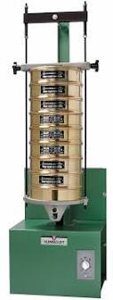
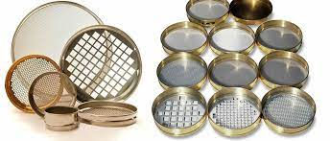
Sieve analysis
Let’s assume that our sample weights 500 gr and the sieve opening (D_{b,i}) are reported below
i | D_{b,i}
 | mm
11 | 0.84
10 | 0.71
9 | 0.5
8 | 0.36
7 | 0.3
6 | 0.25
5 | 0.21
4 | 0.18
3 | 0.15
2 | 0.13
1 | 0.11
0 | PAN
Sieves
Shaker

Slide 30
Sieve analysis
We measure the weight of the sediment trapped on each sieve
i | D_{b,i} | W_{retained}
 | mm | gr
11 | 0.84 | 69.5
10 | 0.71 | 26.5
9 | 0.5 | 146.5
8 | 0.36 | 69.5
7 | 0.3 | 26
6 | 0.25 | 35
5 | 0.21 | 36.5
4 | 0.18 | 24.5
3 | 0.15 | 29.5
2 | 0.13 | 13.5
1 | 0.11 | 11
0 | PAN | 12
Sieves
Shaker

Slide 31
Sieve analysis
We compute the weight of the sediment passing through each sieve (finer than the sieve opening)
i | D_{b,i} | W_{retained} | W_{passing}
 | mm | gr | gr
11 | 0.84 | 69.5 | 430.5
10 | 0.71 | 26.5 | 404
9 | 0.5 | 146.5 | 257.5
8 | 0.36 | 69.5 | 188
7 | 0.3 | 26 | 162
6 | 0.25 | 35 | 127
5 | 0.21 | 36.5 | 90.5
4 | 0.18 | 24.5 | 66
3 | 0.15 | 29.5 | 36.5
2 | 0.13 | 13.5 | 23
1 | 0.11 | 11 | 12
0 | PAN | 12
Sieves
Shaker

Slide 32
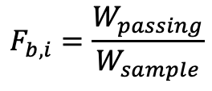
Sieve analysis
We compute the fraction of sediment finer than the sieve opening F_{b,i}
i | D_{b,i} | W_{retained} | W_{passing} | F_{b,i}
 | mm | gr | gr
11 | 0.84 | 69.5 | 430.5 | 0.861
10 | 0.71 | 26.5 | 404 | 0.808
9 | 0.5 | 146.5 | 257.5 | 0.515
8 | 0.36 | 69.5 | 188 | 0.376
7 | 0.3 | 26 | 162 | 0.324
6 | 0.25 | 35 | 127 | 0.254
5 | 0.21 | 36.5 | 90.5 | 0.181
4 | 0.18 | 24.5 | 66 | 0.132
3 | 0.15 | 29.5 | 36.5 | 0.073
2 | 0.13 | 13.5 | 23 | 0.046
1 | 0.11 | 11 | 12 | 0.024
0 | PAN | 12
Sieves
Shaker
$$F_{b,i}=\frac{W_{passing}}{W_{sample}}$$

Slide 33
Grain size distribution
The grain size distribution is described in terms of N+1 sizes D_{bi} (bound diameters) such that F_{bi} denotes the fraction of sediment that is finer than D_{bi}.
i | D_{b,i} | F_{b,i}
 | mm
11 | 0.84 | 0.861
10 | 0.71 | 0.808
9 | 0.5 | 0.515
8 | 0.36 | 0.376
7 | 0.3 | 0.324
6 | 0.25 | 0.254
5 | 0.21 | 0.181
4 | 0.18 | 0.132
3 | 0.15 | 0.073
2 | 0.13 | 0.046
1 | 0.11 | 0.024
100 x F_{b,6} = 25.4
logarithmic scale!

Slide 34
Grain size distribution
The finest size does not correspond to 0 (i.e. 2.4% of the sediment sample is finer than 0.11 mm).
The coarsest size does not correspond to 0.84 mm (i.e. 14% of the sample is coarser than 0.84 mm).
It is often useful to do a linear interpolation on the psi scale to determine the missing values.
i | D_{b,i} | F_{b,i}
 | mm
11 | 0.84 | 0.861
10 | 0.71 | 0.808
9 | 0.5 | 0.515
8 | 0.36 | 0.376
7 | 0.3 | 0.324
6 | 0.25 | 0.254
5 | 0.21 | 0.181
4 | 0.18 | 0.132
3 | 0.15 | 0.073
2 | 0.13 | 0.046
1 | 0.11 | 0.024
logarithmic scale!

Slide 35


Linear interpolation on the psi scale
$ψ_{b,13}=ψ_{b,12}+\frac{ψ_{b,12}−ψ_{b,11}}{F_{b,12}−F_{b,11}}\left(1−F_{b12}\right)$
i | D_{b,i} | Ψ_{b,i} | F_{b,i}
 | mm
13 |  | ? | 1
12 | 0.84 | -0.25 | 0.861
11 | 0.71 | -0.49 | 0.808
10 | 0.5 | -1.00 | 0.515
9 | 0.36 | -1.47 | 0.376
8 | 0.3 | -1.74 | 0.324
7 | 0.25 | -2.00 | 0.254
6 | 0.21 | -2.25 | 0.181
5 | 0.18 | -2.47 | 0.132
4 | 0.15 | -2.74 | 0.073
3 | 0.13 | -2.94 | 0.046
2 | 0.11 | -3.18 | 0.024
1 |  | ? | 0
$$D_{b,13}=2^{ψ_{b,13}}$$

Slide 36


Linear interpolation on the psi scale
$ψ_{b,13}=ψ_{b,12}+\frac{ψ_{b,12}−ψ_{b,11}}{F_{b,12}−F_{b,11}}\left(1−F_{b12}\right)$
i | D_{b,i} | Ψ_{b,i} | F_{b,i}
 | mm
13 | 1.3 | 0.38 | 1
12 | 0.84 | -0.25 | 0.861
11 | 0.71 | -0.49 | 0.808
10 | 0.5 | -1.00 | 0.515
9 | 0.36 | -1.47 | 0.376
8 | 0.3 | -1.74 | 0.324
7 | 0.25 | -2.00 | 0.254
6 | 0.21 | -2.25 | 0.181
5 | 0.18 | -2.47 | 0.132
4 | 0.15 | -2.74 | 0.073
3 | 0.13 | -2.94 | 0.046
2 | 0.11 | -3.18 | 0.024
1 |  | ? | 0
$$D_{b,13}=2^{ψ_{b,13}}$$
$ψ_{b,1}=ψ_{b,2}−\frac{ψ_{b,3}−ψ_{b,2}}{F_{b,3}−F_{b,2}}\left(F_{b,2}−0\right)$
$$D_{b,1}=2^{ψ_{b,1}}$$

Slide 37
Linear interpolation on the psi scale
i | D_{b,i} | Ψ_{b,i} | F_{b,i}
 | mm
13 | 1.3 | 0.38 | 1
12 | 0.84 | -0.25 | 0.861
11 | 0.71 | -0.49 | 0.808
10 | 0.5 | -1.00 | 0.515
9 | 0.36 | -1.47 | 0.376
8 | 0.3 | -1.74 | 0.324
7 | 0.25 | -2.00 | 0.254
6 | 0.21 | -2.25 | 0.181
5 | 0.18 | -2.47 | 0.132
4 | 0.15 | -2.74 | 0.073
3 | 0.13 | -2.94 | 0.046
2 | 0.11 | -3.18 | 0.024
1 | 0.09 | -3.45 | 0

Slide 38
Characteristic sizes, D₅₀, D₉₀, D_{x}
D_{X} = diameter such that X% of the sediment is finer
D₅₀ = median size
D₉₀ = scale for the roughness height
i | D_{b,i} | Ψ_{b,i} | F_{b,i}
 | mm
13 | 1.31 | 0.38 | 1.00
12 | 0.84 | -0.25 | 0.86
11 | 0.71 | -0.49 | 0.81
10 | 0.50 | -1.00 | 0.52
9 | 0.36 | -1.47 | 0.38
8 | 0.30 | -1.74 | 0.32
7 | 0.25 | -2.00 | 0.25
6 | 0.21 | -2.25 | 0.18
5 | 0.18 | -2.47 | 0.13
4 | 0.15 | -2.74 | 0.07
3 | 0.13 | -2.94 | 0.05
2 | 0.11 | -3.18 | 0.02
1 | 0.09 | -3.45 | 0.00
D₅₀

Slide 39
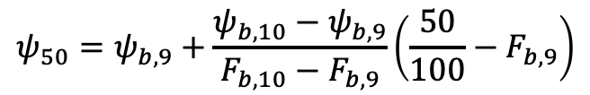

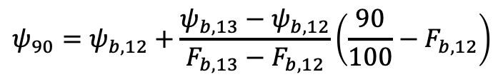

Characteristic sizes, D₅₀, D₉₀, D_{x}
D_{X} = diameter such that X% of the sediment is finer
D₅₀ = median size
D₉₀ = scale for the roughness height
i | D_{b,i} | Ψ_{b,i} | F_{b,i}
 | mm
13 | 1.31 | 0.38 | 1.00
12 | 0.84 | -0.25 | 0.86
11 | 0.71 | -0.49 | 0.81
10 | 0.50 | -1.00 | 0.52
9 | 0.36 | -1.47 | 0.38
8 | 0.30 | -1.74 | 0.32
7 | 0.25 | -2.00 | 0.25
6 | 0.21 | -2.25 | 0.18
5 | 0.18 | -2.47 | 0.13
4 | 0.15 | -2.74 | 0.07
3 | 0.13 | -2.94 | 0.05
2 | 0.11 | -3.18 | 0.02
1 | 0.09 | -3.45 | 0.00
$$ψ_{90}=ψ_{b,12}+\frac{ψ_{b,13}−ψ_{b,12}}{F_{b,13}−F_{b,12}}\left(\frac{90}{100}−F_{b,12}\right)$$
$$D_{90}=2^{ψ_{90}}$$
$$ψ_{50}=ψ_{b,9}+\frac{ψ_{b,10}−ψ_{b,9}}{F_{b,10}−F_{b,9}}\left(\frac{50}{100}−F_{b,9}\right)$$
$$D_{50}=2^{ψ_{50}}$$
D₅₀
For our sediment
D₅₀ = 0.48 mm and D₉₀ = 0.95 mm

Slide 40
Characteristic diameters D_{i}
i | D_{b,i} | Ψ_{b,i} | F_{b,i}
 | mm
13 | 1.31 | 0.38 | 1.00
12 | 0.84 | -0.25 | 0.86
11 | 0.71 | -0.49 | 0.81
10 | 0.50 | -1.00 | 0.52
9 | 0.36 | -1.47 | 0.38
8 | 0.30 | -1.74 | 0.32
7 | 0.25 | -2.00 | 0.25
6 | 0.21 | -2.25 | 0.18
5 | 0.18 | -2.47 | 0.13
4 | 0.15 | -2.74 | 0.07
3 | 0.13 | -2.94 | 0.05
2 | 0.11 | -3.18 | 0.02
1 | 0.09 | -3.45 | 0.00
F_{b,11}
f₁₀ = F_{b,11}- F_{b,10}
F_{b,10}
D_{b,11}
D_{i=10}

Slide 41

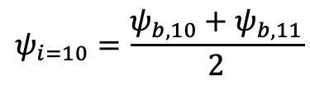
Characteristic diameters D_{i}
D_{i=10} = characteristic size of sediment with grain size between D_{b,10} and D_{b,11}
i | D_{b,i} | Ψ_{b,i} | F_{b,i}
 | mm
13 | 1.31 | 0.38 | 1.00
12 | 0.84 | -0.25 | 0.86
11 | 0.71 | -0.49 | 0.81
10 | 0.50 | -1.00 | 0.52
9 | 0.36 | -1.47 | 0.38
8 | 0.30 | -1.74 | 0.32
7 | 0.25 | -2.00 | 0.25
6 | 0.21 | -2.25 | 0.18
5 | 0.18 | -2.47 | 0.13
4 | 0.15 | -2.74 | 0.07
3 | 0.13 | -2.94 | 0.05
2 | 0.11 | -3.18 | 0.02
1 | 0.09 | -3.45 | 0.00
$$D_{i=10}=\sqrt{D_{b,10}D_{b,11}}$$
geometric mean
F_{b,11}
$$ψ_{i=10}=\frac{ψ_{b,10}+ψ_{b,11}}{2}$$
arithmetic mean
f₁₀ = F_{b,11}- F_{b,10}
F_{b,10}
D_{b,11}
D_{i=10}

Slide 42

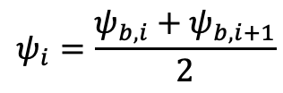


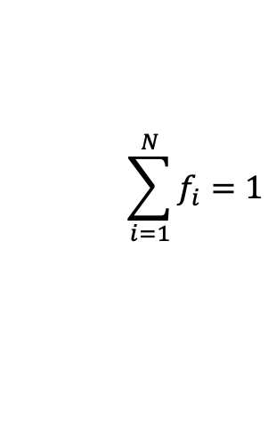
Characteristic diameters D_{i}
D_{i=10} = characteristic size of sediment with grain size between D_{b,10} and D_{b,11}
i | D_{b,i} | Ψ_{b,i} | F_{b,i}
 | mm
13 | 1.31 | 0.38 | 1.00
12 | 0.84 | -0.25 | 0.86
11 | 0.71 | -0.49 | 0.81
10 | 0.50 | -1.00 | 0.52
9 | 0.36 | -1.47 | 0.38
8 | 0.30 | -1.74 | 0.32
7 | 0.25 | -2.00 | 0.25
6 | 0.21 | -2.25 | 0.18
5 | 0.18 | -2.47 | 0.13
4 | 0.15 | -2.74 | 0.07
3 | 0.13 | -2.94 | 0.05
2 | 0.11 | -3.18 | 0.02
1 | 0.09 | -3.45 | 0.00
$$D_{i=10}=\sqrt{D_{b,10}D_{b,11}}$$
geometric mean
F_{b,11}
$$ψ_{i=10}=\frac{ψ_{b,10}+ψ_{b,11}}{2}$$
arithmetic mean
f₁₀ = F_{b,11}- F_{b,10}
General form
F_{b,10}
$$D_{i}=\sqrt{D_{b,i}D_{b,i+1}}$$
$$ψ_{i}=\frac{ψ_{b,i}+ψ_{b,i+1}}{2}$$
$$D_{i}=2^{ψ_{i}}$$
f_{i} = volume fraction content of sediment with grain size between D_{b,i} and D_{b,i+1} in the sediment sample
D_{b,11}
$$f_{i}=F_{b,i+1}−F_{b,i}$$
D_{i=10}
$$\sum_{i=1}^{N}{f_{i}=1}$$

Slide 43
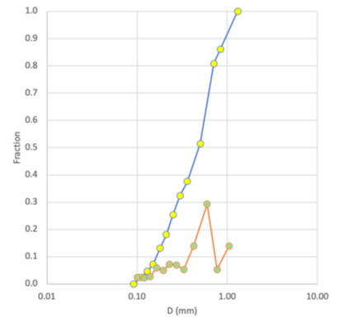

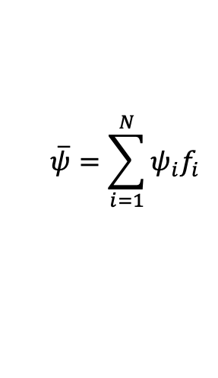

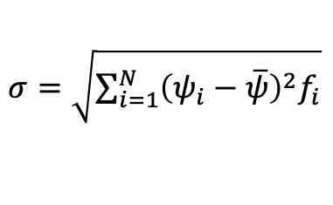
Geometric mean diameter D_{g} and geometric standard deviation σ_{g}
$$\overline{ψ}=\sum_{i=1}^{N}{ψ_{i}f_{i}}$$
$σ=\sqrt{\sum_{i=1}^{N}{{\left(ψ_{i}−\overline{ψ}\right)}^{2}f_{i}}}$
$$D_{g}=2^{\overline{ψ}}$$
$$σ_{g}=2^{σ}$$
sediment is well-sorted (uniform) when σ_{g} < 1.6
i | D_{b,i} | Y_{b,i} | F_{b,i} | D_{i} | Y_{i} | f_{i}
 | mm |  |  | mm
13 | 1.31 | 0.38 | 1.00 | 1.05 | 0.07 | 0.14
12 | 0.84 | -0.25 | 0.86 | 0.77 | -0.37 | 0.05
11 | 0.71 | -0.49 | 0.81 | 0.60 | -0.75 | 0.29
10 | 0.50 | -1.00 | 0.52 | 0.42 | -1.24 | 0.14
9 | 0.36 | -1.47 | 0.38 | 0.33 | -1.61 | 0.05
8 | 0.30 | -1.74 | 0.32 | 0.27 | -1.87 | 0.07
7 | 0.25 | -2.00 | 0.25 | 0.23 | -2.13 | 0.07
6 | 0.21 | -2.25 | 0.18 | 0.19 | -2.36 | 0.05
5 | 0.18 | -2.47 | 0.13 | 0.16 | -2.61 | 0.06
4 | 0.15 | -2.74 | 0.07 | 0.14 | -2.84 | 0.03
3 | 0.13 | -2.94 | 0.05 | 0.12 | -3.06 | 0.02
2 | 0.11 | -3.18 | 0.02 | 0.10 | -3.32 | 0.02
1 | 0.09 | -3.45 | 0.00
For our sediment
D_{g} = 0.42 mm and σ_{g} = 1.81

Slide 44
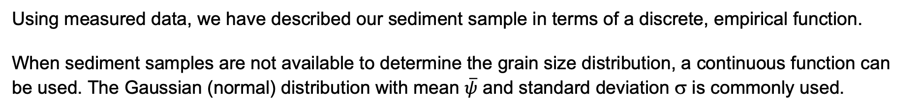
Unimodal and bimodal grain size distributions
Using measured data, we have described our sediment sample in terms of a discrete, empirical function.
When sediment samples are not available to determine the grain size distribution, a continuous function can be used. The Gaussian (normal) distribution with mean $\overline{ψ}$ and standard deviation σ is commonly used.

Slide 45
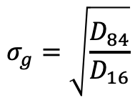

Unimodal and bimodal grain size distributions
Using measured data, we have described our sediment sample in terms of a discrete, empirical function.
When sediment samples are not available to determine the grain size distribution, a continuous function can be used. The Gaussian (normal) distribution with mean $\overline{ψ}$ and standard deviation σ is commonly used.
Gaussian approximation of our sediment sample
A grain size distribution that can be described with a Gaussian distribution is unimodal, as it has a single mode or peak.
The following approximations are valid for a Gaussian distribution
$$σ_{g}=\sqrt{\frac{D_{84}}{D_{16}}}$$
$$D_{g}=\sqrt{D_{84}D_{16}}$$

Slide 46
Unimodal and bimodal grain size distributions
A sand bed river has a characteristic size of the bed surface sediment (D_{sg}, D_{s50}) that is in the sand range of sediment sizes.
The grain size distribution of many sand bed rivers are unimodal and can be reasonably approximated with a Gaussian distribution

Slide 47
Unimodal and bimodal grain size distributions
A sand bed river has a characteristic size of the bed surface sediment (D_{sg}, D_{s50}) that is in the sand range of sediment sizes.
The grain size distribution of many sand bed rivers are unimodal and can be reasonably approximated with a Gaussian distribution
A gravel bed river has a characteristic size of the bed surface sediment (D_{sg}, D_{s50}) that is in the gravel range of sediment sizes.
The grain size distribution of many gravel bed rivers is bimodal (multimodal), with a sand mode, a gravel mode and a plateau showing a paucity of sediment in the pea-gravel range (2 mm – 8 mm).
plateau
gravel mode
sand mode

Slide 48
Sediment fall velocity in still water
Let’s consider a spherical particle with diameter D, density ρR and fall velocity v_{s}, with R being the submerged specific gravity of the sediment and ρ the water density

Slide 49
Sediment fall velocity in still water (Dietrich, 1982)
Let’s consider a spherical particle with diameter D, density ρR and fall velocity v_{s}, with R being the submerged specific gravity of the sediment and ρ the water density
F_{g} = downstream impelling force of gravity
F_{D}
F_{D} = resistive drag force
F_{g}
we want to find a relation to express fall velocity as a function of sediment and fluid properties

Slide 50
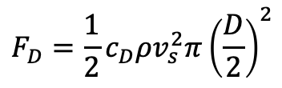
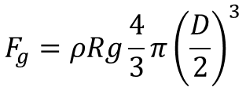
Sediment fall velocity in still water (Dietrich, 1982)
Let’s consider a spherical particle with diameter D, density ρR and fall velocity v_{s}, with R being the submerged specific gravity of the sediment and ρ the water density
F_{g} = downstream impelling force of gravity
F_{D}
F_{D} = resistive drag force
$$F_{g}=ρRg\frac{4}{3}π{\left(\frac{D}{2}\right)}^{3}$$
$$F_{D}=\frac{1}{2}c_{D}ρv_{s}^{2}π{\left(\frac{D}{2}\right)}^{2}$$
F_{g}
c_{D} is the drag coefficient,

Slide 51


Sediment fall velocity in still water (Dietrich, 1982)
Let’s consider a spherical particle with diameter D, density ρR and fall velocity v_{s}, with R being the submerged specific gravity of the sediment and ρ the water density
F_{g} = downstream impelling force of gravity
F_{D}
F_{D} = resistive drag force
$$F_{g}=ρRg\frac{4}{3}π{\left(\frac{D}{2}\right)}^{3}$$
from the e-book (chapter 6)
$$F_{D}=\frac{1}{2}c_{D}ρv_{s}^{2}π{\left(\frac{D}{2}\right)}^{2}$$
F_{g}
c_{D} is the drag coefficient, and it is a function of the Reynolds number
$$Re=\frac{u_{f}D}{ν}$$
with ν being the kinematic viscosity of water and u_{f} the velocity of the fluid relative to the sphere.
In the case of a particle in still water u_{f} = v_{s} and
$$Re={Re}_{vp}=\frac{v_{s}D}{ν}$$

Slide 52
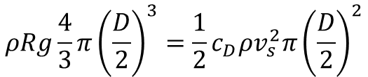


Sediment fall velocity in still water (Dietrich, 1982)
Let’s consider a spherical particle with diameter D, density ρR and fall velocity v_{s}, with R being the submerged specific gravity of the sediment and ρ the water density
F_{g} = downstream impelling force of gravity
F_{D}
F_{D} = resistive drag force
$$F_{g}=ρRg\frac{4}{3}π{\left(\frac{D}{2}\right)}^{3}$$
$$F_{D}=\frac{1}{2}c_{D}ρv_{s}^{2}π{\left(\frac{D}{2}\right)}^{2}$$
$${Re}_{vp}=\frac{v_{s}D}{ν}$$
F_{g}
$$c_{D}=f\left({Re}_{vp}\right)$$
Condition for equilibrium F_{g} = F_{D}
$$ρRg\frac{4}{3}π{\left(\frac{D}{2}\right)}^{3}=\frac{1}{2}c_{D}ρv_{s}^{2}π{\left(\frac{D}{2}\right)}^{2}$$

Slide 53
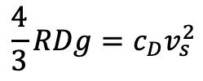
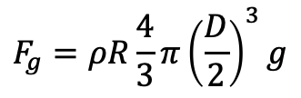
Sediment fall velocity in still water (Dietrich, 1982)
Let’s consider a spherical particle with diameter D, density ρR and fall velocity v_{s}, with R being the submerged specific gravity of the sediment and ρ the water density
F_{g} = downstream impelling force of gravity
F_{D}
F_{D} = resistive drag force
$$F_{g}=ρR\frac{4}{3}π{\left(\frac{D}{2}\right)}^{3}g$$
$$F_{D}=\frac{1}{2}c_{D}ρv_{s}^{2}π{\left(\frac{D}{2}\right)}^{2}$$
$${Re}_{vp}=\frac{v_{s}D}{ν}$$
F_{g}
$$c_{D}=f\left({Re}_{vp}\right)$$
Condition for equilibrium F_{g} = F_{D}
$$ρRg\frac{4}{3}π{\left(\frac{D}{2}\right)}^{3}=\frac{1}{2}c_{D}ρv_{s}^{2}π{\left(\frac{D}{2}\right)}^{2}$$
$$\frac{4}{3}RDg=c_{D}v_{s}^{2}$$
simplifies into

Slide 54
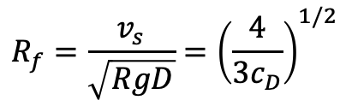
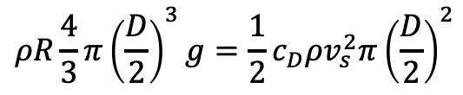
Sediment fall velocity in still water (Dietrich, 1982)
Let’s consider a spherical particle with diameter D, density ρR and fall velocity v_{s}, with R being the submerged specific gravity of the sediment and ρ the water density
F_{g} = downstream impelling force of gravity
F_{D}
F_{D} = resistive drag force
$$F_{g}=ρR\frac{4}{3}π{\left(\frac{D}{2}\right)}^{3}g$$
$$F_{D}=\frac{1}{2}c_{D}ρv_{s}^{2}π{\left(\frac{D}{2}\right)}^{2}$$
$${Re}_{vp}=\frac{v_{s}D}{ν}$$
F_{g}
$$c_{D}=f\left({Re}_{vp}\right)$$
we want to find a relation to express fall velocity as a function of sediment and fluid properties
Condition for equilibrium F_{g} = F_{D}
$$ρR\frac{4}{3}π{\left(\frac{D}{2}\right)}^{3}g=\frac{1}{2}c_{D}ρv_{s}^{2}π{\left(\frac{D}{2}\right)}^{2}$$
$$\frac{4}{3}RDg=c_{D}v_{s}^{2}$$
simplifies into
rearranging the terms
$$R_{f}=\frac{v_{s}}{\sqrt{RgD}}={\left(\frac{4}{3c_{D}}\right)}^{1/2}$$

Slide 55
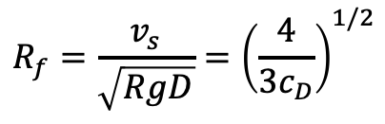

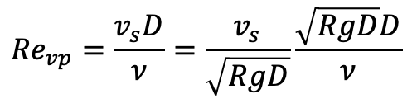
Sediment fall velocity in still water (Dietrich, 1982)
$$R_{f}=\frac{v_{s}}{\sqrt{RgD}}={\left(\frac{4}{3c_{D}}\right)}^{1/2}$$
$$c_{D}=f\left({Re}_{vp}\right)$$
F_{D}
$${Re}_{vp}=\frac{v_{s}D}{ν}=\frac{v_{s}}{\sqrt{RgD}}\frac{\sqrt{RgD}D}{ν}$$
F_{g}

Slide 56
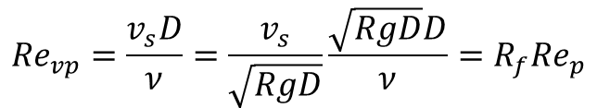
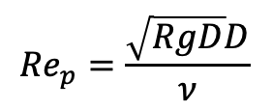
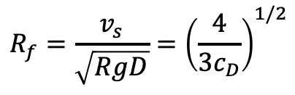
Sediment fall velocity in still water (Dietrich, 1982)
$$R_{f}=\frac{v_{s}}{\sqrt{RgD}}={\left(\frac{4}{3c_{D}}\right)}^{1/2}$$
$$c_{D}=f\left({Re}_{vp}\right)$$
F_{D}
Re_{p} = particle Reynolds number
$${Re}_{vp}=\frac{v_{s}D}{ν}=\frac{v_{s}}{\sqrt{RgD}}\frac{\sqrt{RgD}D}{ν}=R_{f}{Re}_{p}$$
$${Re}_{p}=\frac{\sqrt{RgD}D}{ν}$$
F_{g}

Slide 57
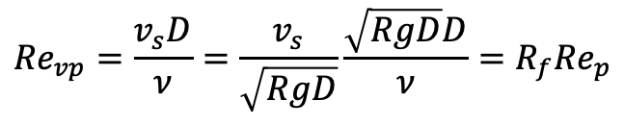
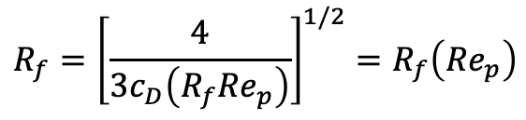
Sediment fall velocity in still water (Dietrich, 1982)
$$R_{f}=\frac{v_{s}}{\sqrt{RgD}}={\left(\frac{4}{3c_{D}}\right)}^{1/2}$$
$$c_{D}=f\left({Re}_{vp}\right)$$
F_{D}
Re_{p} = particle Reynolds number
$${Re}_{vp}=\frac{v_{s}D}{ν}=\frac{v_{s}}{\sqrt{RgD}}\frac{\sqrt{RgD}D}{ν}=R_{f}{Re}_{p}$$
$${Re}_{p}=\frac{\sqrt{RgD}D}{ν}$$
We found a relation between the particle fall velocity and the properties of the particle and of the fluid
$$R_{f}={\left[\frac{4}{3c_{D}\left(R_{f}{Re}_{p}\right)}\right]}^{1/2}=R_{f}\left({Re}_{p}\right)$$
F_{g}
Relation by Dietrich (1982) without correction for particle shape
b₁ | 2.891394
b₂ | 0.95296
b₃ | 0.056835
b₄ | 0.002892
b₅ | 0.000245
$$R_{f}=exp\left\{−b_{1}+b_{2}ln\left({Re}_{p}\right)−b_{3}{\left[ln\left({Re}_{p}\right)\right]}^{2}−b_{4}{\left[ln\left({Re}_{p}\right)\right]}^{3}+b_{5}{\left[ln\left({Re}_{p}\right)\right]}^{4}\right\}$$

Slide 58
Sediment fall velocity in still water (Dietrich, 1982)
$$R_{f}=\frac{v_{s}}{\sqrt{RgD}}={\left(\frac{4}{3c_{D}}\right)}^{1/2}$$
$$c_{D}=f\left({Re}_{vp}\right)$$
F_{D}
Re_{p} = particle Reynolds number
$${Re}_{vp}=\frac{v_{s}D}{ν}=\frac{v_{s}}{\sqrt{RgD}}\frac{\sqrt{RgD}D}{ν}=R_{f}{Re}_{p}$$
$${Re}_{p}=\frac{\sqrt{RgD}D}{ν}$$
We found a relation between the particle fall velocity and the properties of the particle and of the fluid
$$R_{f}={\left[\frac{4}{3c_{D}\left(R_{f}{Re}_{p}\right)}\right]}^{1/2}=R_{f}\left({Re}_{p}\right)$$
F_{g}
Relation by Dietrich (1982) without correction for particle shape
b₁ | 2.891394
b₂ | 0.95296
b₃ | 0.056835
b₄ | 0.002892
b₅ | 0.000245
$$R_{f}=exp\left\{−b_{1}+b_{2}ln\left({Re}_{p}\right)−b_{3}{\left[ln\left({Re}_{p}\right)\right]}^{2}−b_{4}{\left[ln\left({Re}_{p}\right)\right]}^{3}+b_{5}{\left[ln\left({Re}_{p}\right)\right]}^{4}\right\}$$
Another excel file, the fall velocity calculator.

Slide 59
References
Einstein, H.A., Anderson, A..G., & Johnson, J.W. (1940) Distinction between bed-load and suspended load in natural streams. Transactions, A/merican Geophysical Union 21 (2), 628-633
Dietrich, W. E. (1982). Settling velocity of natural particles. Water Resources Research 18 (6), 1615-1626.
Church, M. (2006). Bed Material Transport and the Morphology of Alluvial River Channels. Annual Review of Earth and Planetary Science 34, 325-354.

